Slide 1
Mall & Retails
Solution

Slide 2
Agenda
Challenges faced by Malls & Retails
Shining Bot Solution Architecture
How Shining Bot addresses your need
Contact details

Slide 3
Challenges faced by Malls & Retails
Lack of Customer insights
Do not the insight regarding who are the visitors, their visiting pattern, trend, likes & dislike, etc.
Maintaining Customer Loyalty
Retaining the loyalty starts with insights, how you measure the loyalty other than simple cards & coupons
Optimum usage of space & costing
Which are the most used/unused space, how to fix cost?
How to take the Mall/Retail to their home
How to engage the customers when they are not in our premises? Why not take the Mall/Retail to their home?

Slide 4
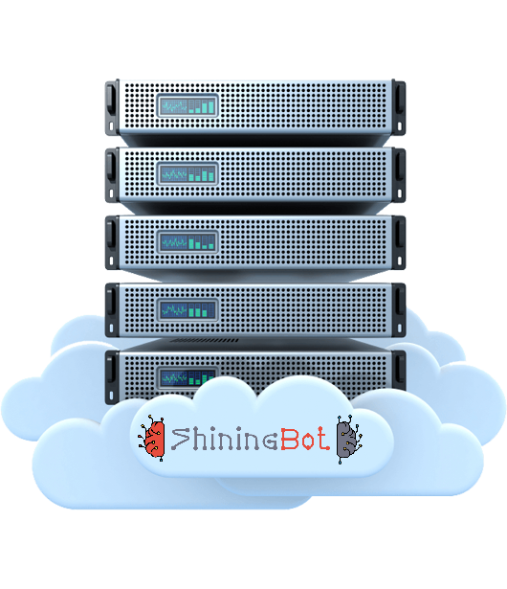
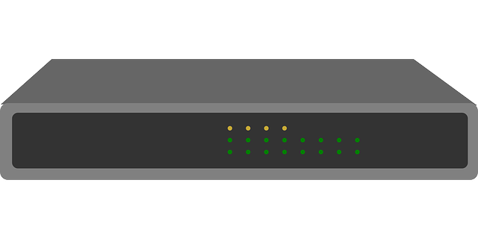
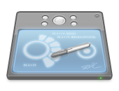
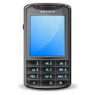
Hardware Architecture
Internet
Access Point
Wireless Controller (Optional)
Server (Optional)
Wireless Clients (Laptop/Tab/Mobile)
Shining Bot Cloud Infrastructure
Customer in-premises Infrastructure

Slide 5
How Shining Bot works …
Customer Profiling & Classification
Registration
Details
Machine
Learning
Check-in
Sign-in
Customer
Data
Source
Check-out
Sign-out
Business Intelligence
& KPI Reports
Internet
Usage
Feedback
Information
Shining Bot
Omicron Engine
Automated Marketing by SMS / WhatsApp / Email

Slide 6
Product Features
Customer Profiling & Classification
Shining Bot Machine Learning Engine profiles customers based on economic status for marketing
Digital Signage
Display full-hd Signages on Android TV using ShiningBot DS television APP and control via web
Self Service Menu, Order & KOT Printing
Manage restaurant, room-service & amenities delivery via automatic self service system using QR Code & Mobile browser
VIP Recognition
Recognize your important customer customers across your outlets and give preferential treatment
Location based Service & Advertisement
Machine Learning Engine understands customer interests based on their location & advertises in login & status pages
Feedback Management
Collect feedback from your customer using Tablet based feedback management system & reports
AI based Automated Marketing
Automatically markets products & services based on the customer interests and preferences
Content Filter
Industry Standard Category based Content Filter with complete user control for URL filtering
Business Intelligence & KPI
Provides advanced reports and Key Performance Indicator data based on the various inputs
Authentication & Log Management
Authenticate users with complete control & Manages logs as per Industry Standard
Application Programming Interface
Extend the Shining Bot capabilities with our API to connect with your customized software

Slide 7
Why Shining Bot …
Exploit the power of Ai & Machine Learning technology for your business development
Provides complete insights about business and operation using WiFi
State of the art solution to improve the business process & profits
Explore the hidden data in your business to exploit the opportunities
It follows your customer even outside your business premises
Increases customer satisfaction by enhancing the experience

Slide 8
How we address the challenges

Slide 9
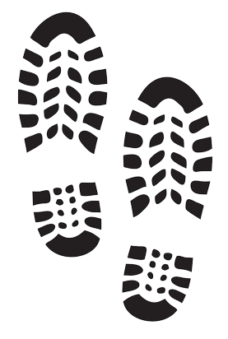
Improving the Footfall
Free WiFi in your business premises is an easy and first step to attract more walk-ins
Most users engage in social media sites, that indirectly attracts new walk-in to your premises
Registration helps you to collect various details about your potential customer including mobile number
Access to WiFi during each visit automatically builds customer insights data for next steps
Understand the “Customer Dwell Time” – a KPI to learn more about their behaviour
Their movement within your premises helps the system to learn about their interest and behaviour

Slide 10
Making you more aware of your customers/visitors
Shining Bot provides the following insights:
Registration details (provided by visitor)
Mobile number (verified by OTP)
Devices used (Automatic detection)
Time spent & Visiting pattern & trends
Locations visited and time spent at each location
Additional Omicron insights
Profiling & Classification identifying the economic status
Product / Service interested in
Customer Dwell Time – KPI report
Customer Retention – KPI report
Customer Satisfaction – KPI report
Sentiment analysis on feedbacks provided

Slide 11
Increasing Customer Loyalty
Brand recall plays important role in nurturing loyalty among your customer. Out of sight is out of mind
Our solution helps to improve brand recall by:
Makes customer feel special by Wishes & Greetings
Announces about their interested product/service
Sends short URL requesting them to submit feedback
Track their visiting pattern and follow up when they do not engage after some time
Send promotional offers as per business policy
Send Thank You message to visiting customers

Slide 12
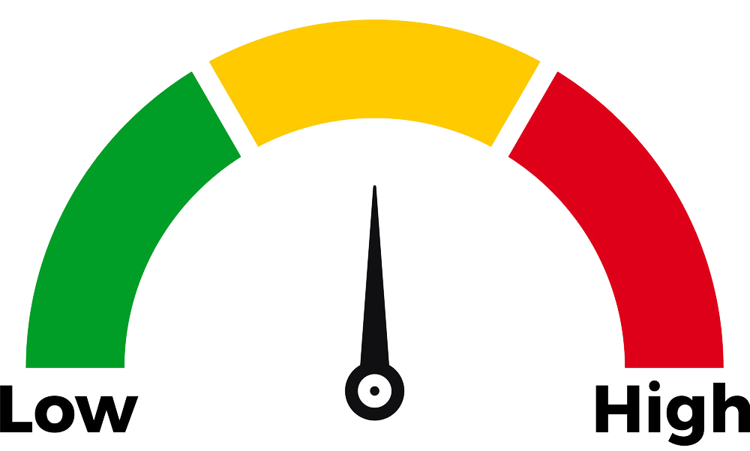
Maximizing the revenue by space usage
Provides complete information on utilization of space in your premises.
Most Used space & Time at which most used
Most Unused space & Time at which most unused
Current occupancy status at each location
Push SMS based on entry/exit to particular location
Movement trend & pattern
Maximizing Revenue
Charge space based on usage
Reorganize the space to minimize the lift usage
Improve footfall on unused space by new plans

Slide 13
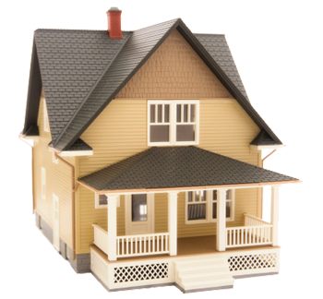
Take the Mall/Retail to customer’s home
Imagine the possibilities when you can engage the customer even when they are not in your premises:
Wishing & Greeting SMS / WhatsApp messages to registered users
Short URL feedback request
Thank you note to visiting customers
Welcome message, if they don’t engage for a period
Automatic SMS / WhatsApp to customer on stock replenishments based on their interested product / service
Promotional offers based on business policy

Slide 14
ShiningBot Data Analytics (P) Limited
F3 – Nathigam Building, 97/55, NSK Salai (Arcot Road), Kodambakkam, Chennai – 600 024, TN, India
www.shiningbot.com | info@shiningbot.com

