Slide 1

Healthcare Solutions

Slide 2

Agenda
Challenges in Healthcare
Shining Bot Solution Architecture
How Shining Bot addresses your need
Contact details

Slide 3

Challenges in Hospitality & Clubs
Patients feel lonely
  Most sick patients feel lonely and prefer to be touch with their family members all time. But hospitals cannot entertain this due to health and safety reasons.
Large visitors and maintenance after visiting hours
  Friends and relatives like to visit admitted patients, but visitors are tough to handle from management view.
Patient’s attenders find difficult to pass time
  Attenders are forced to stay with patient without any productivity.
People hate to wait or sit idle
  Waiting is unavoidable in hospitals especially in out-patient sections, they look for ways to entertain themselves and engage in productive works.

Slide 4
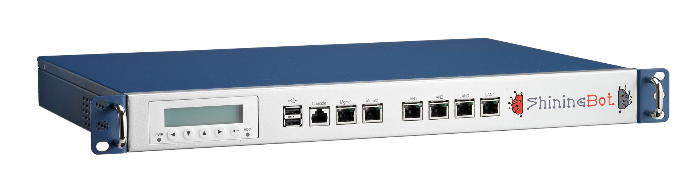





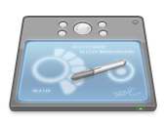
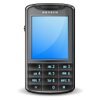
Hardware Architecture
Internet
Access Point
Wireless Controller (Optional)
Server (Optional)
Wireless Clients (Laptop/Tab/Mobile)
Shining Bot Cloud Infrastructure
Customer in-premises Infrastructure

Slide 5











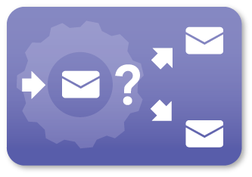
How Shining Bot works …
Customer Profiling & Classification
Registration
Details
Machine
Learning
Check-in
Sign-in
Customer
Data
Source
Check-out
Sign-out
Business Intelligence
& KPI Reports
Internet
Usage
Feedback
Information
Shining Bot
Omicron Engine
Automated Marketing by SMS / WhatsApp / Email

Slide 6



Product Features
Customer Profiling & Classification
Shining Bot Machine Learning Engine profiles customers based on economic status for marketing
Digital Signage
Display full-hd Signages on Android TV using ShiningBot DS television APP and control via web
Self Service Menu, Order & KOT Printing
Manage restaurant, room-service & amenities delivery via automatic self service system using QR Code & Mobile browser
VIP Recognition
Recognize your important customer customers across your outlets and give preferential treatment
Location based Service & Advertisement
Machine Learning Engine understands customer interests based on their location & advertises in login & status pages
Feedback Management
Collect feedback from your customer using Tablet based feedback management system & reports
AI based Automated Marketing
Automatically markets products & services based on the customer interests and preferences
Content Filter
Industry Standard Category based Content Filter with complete user control for URL filtering
Business Intelligence & KPI
Provides advanced reports and Key Performance Indicator data based on the various inputs
Authentication & Log Management
Authenticate users with complete control & Manages logs as per Industry Standard
Application Programming Interface
Extend the Shining Bot capabilities with our API to connect with your customized software

Slide 7
Why Shining Bot …
Exploit the power of Ai & Machine Learning technology for your business development
Provides complete insights about business and operation using WiFi
State of the art solution to improve the business process & profits
Explore the hidden data in your business to exploit the opportunities
It follows your customer even outside your business premises
Increases customer satisfaction by enhancing the experience

Slide 8
How we address the challenges

Slide 9

Enables patients to be in touch with others
ShiningBot offers WiFi Service
  Patients can be in touch with others using their mobile devices
  Many hospitals helped COVID patients to be in touch with their family during their tough time using this technology
  Hospitals provided Tablets in the in-patient wards and shared the Video Conference App ID to their family members for easy access
  Patients can use internet service to access their preferred television channels and continue to enjoy their shows
  Employees can use Internet to remotely work
  Helps hospital to avoid visitors

Slide 10

Attenders can use their time productively
Many organization allow their employees to work remotely. Using WiFi attenders can work while they stay with patients
High-Speed WiFi service is sold in many hospitals at attracts additional revenue to hospital
Internet allows people to communicate and be in touch with others
Many Online and OTT platforms can be used for additional entertainment / time pass.

Slide 11
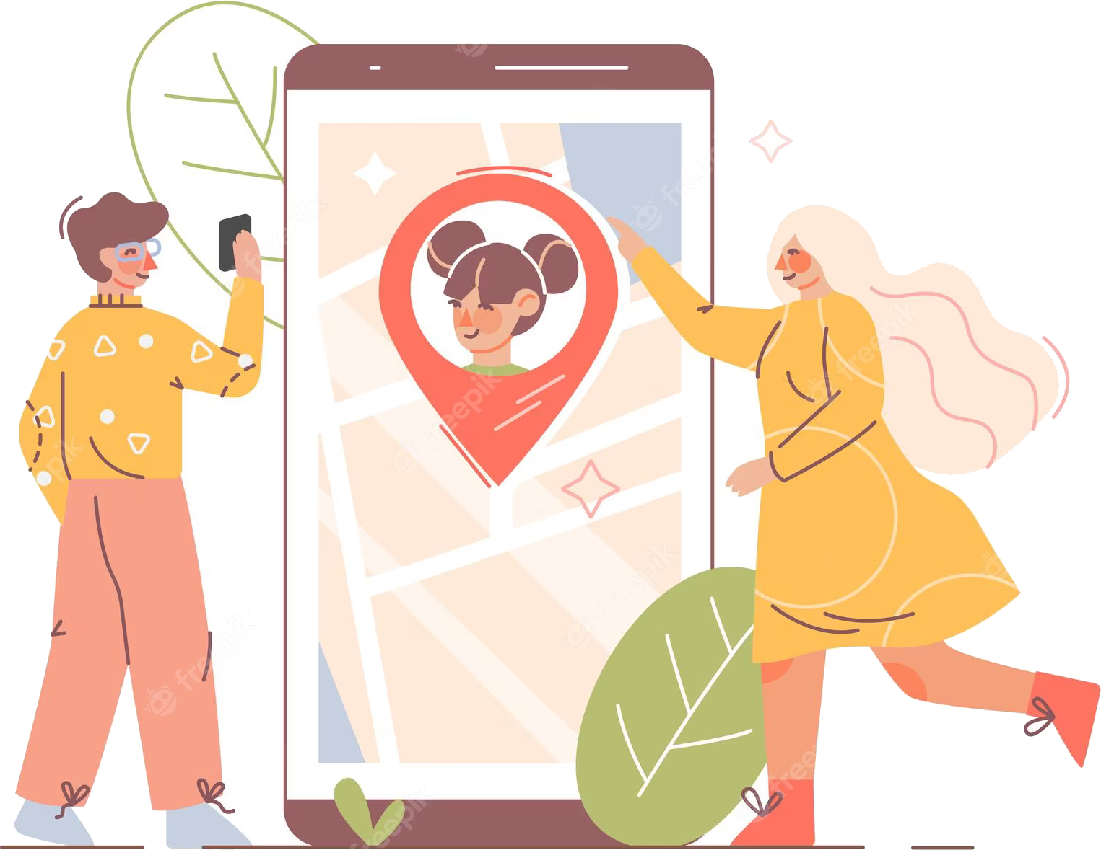
People hate to wait / sit - idle
Generally, people hate to wait, if WiFi is available many people do not mind waiting as they can spend time in their preferred manner
WiFi registration process can also be used to provide token system to prioritise the visits
ShiningBot can also help to send reminders to patient regarding their next visit
ShiningBot can automatically track the visiting pattern and reminders can be send to no-show patients

Slide 12

ShiningBot Data Analytics (P) Limited
F3 – Nathigam Building, 97/55, NSK Salai (Arcot Road), Kodambakkam, Chennai – 600 024, TN, India
www.shiningbot.com | info@shiningbot.com

