Slide 1

Product
Overview

Slide 2

Agenda
Architecture
Product Features
Why Shining Bot?
Contact details

Slide 3
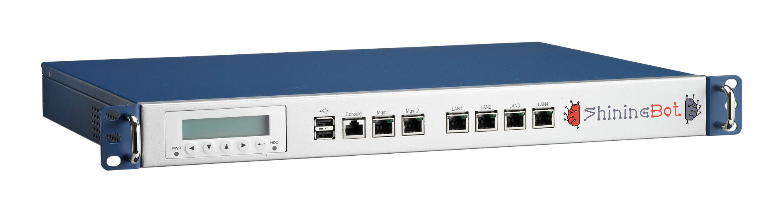
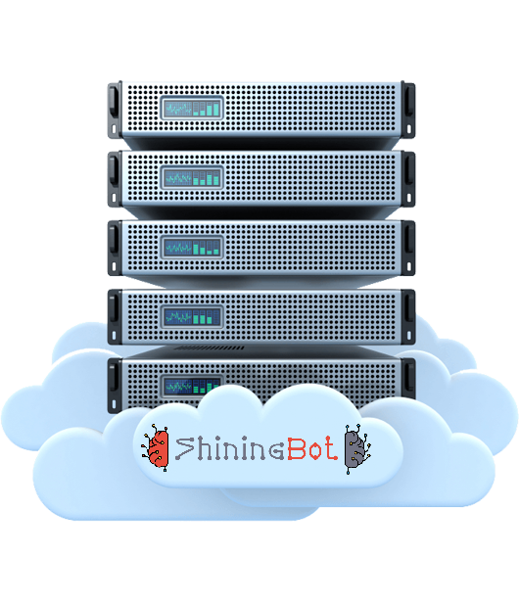


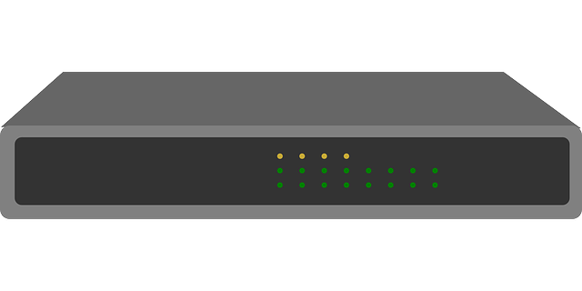
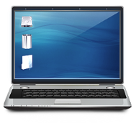
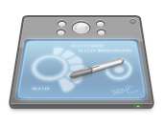
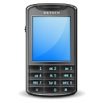
Hardware Architecture
Internet
Access Point
Wireless Controller (Optional)
Server (Optional)
Wireless Clients (Laptop/Tab/Mobile)
Shining Bot Cloud Infrastructure
Customer in-premises Infrastructure

Slide 4












How Shining Bot works …
Customer Profiling & Classification
Registration
Details
Machine
Learning
Check-in
Sign-in
Customer
Data
Source
Check-out
Sign-out
Business Intelligence
& KPI Reports
Internet
Usage
Feedback
Information
ShiningBot
Omicron Engine
Automated Marketing by SMS / WhatsApp / Email

Slide 5



Product Features
Customer Profiling & Classification
Shining Bot Machine Learning Engine profiles customers based on economic status for marketing
Digital Signage
Display full-hd Signages on Android TV using ShiningBot DS television APP and control via web
Self Service Menu, Order & KOT Printing
Manage restaurant, room-service & amenities delivery via automatic self service system using QR Code & Mobile browser
VIP Recognition
Recognize your important customer customers across your outlets and give preferential treatment
Location based Service & Advertisement
Machine Learning Engine understands customer interests based on their location & advertises in login & status pages
Feedback Management
Collect feedback from your customer using Tablet based feedback management system & reports
AI based Automated Marketing
Automatically markets products & services based on the customer interests and preferences
Content Filter
Industry Standard Category based Content Filter with complete user control for URL filtering
Business Intelligence & KPI
Provides advanced reports and Key Performance Indicator data based on the various inputs
Authentication & Log Management
Authenticate users with complete control & Manages logs as per Industry Standard
Application Programming Interface
Extend the Shining Bot capabilities with our API to connect with your customized software

Slide 6

Authentication & Log Management
In built user registration with validation
Password delivery by SMS (OTP)
User authentication & Tracking
Bandwidth control (Speed & Download limit)
Concurrent access control
Log as per Industry Standard
Log retention for 18 months as per norms
Investigation support for violations
API connectors to PMS or external source

Slide 7

Content Filter
55 Categories
Over 30 million websites classified
Realtime on-the-fly classification for new sites
Custom URL Filter for unique needs
Custom exemption list to override filter
Custom blocking list to override filter
Complete visibility on usage
Easy to use dashboard & Reports
Integrated within ShiningBot console

Slide 8
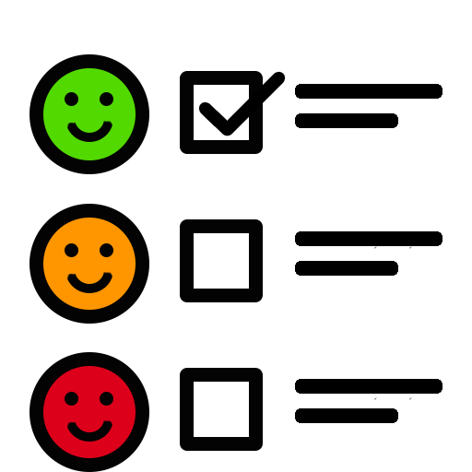
Feedback Management
Login/Logout/Status page provides feedback link
Customizable feedback forms
Complete feedback reports in dashboard
AI based automatic sentiment analysis
Escalate to next level based on threshold
Follow the customer with short URL
Optional feature to share escalation matrix
Compare various feedback by same user
Generates KPI reports based on feedback

Slide 9

VIP Recognition
Make customers feel special by recognition
Recognize customer across various outlets
Alert/Notify responsible staff by SMS
Find their current location in your premises
  Location based service required to find location
Get report of VIP visitor list
Automatically deliver WiFi Password to VIP
Send short URL link for feedback

Slide 10
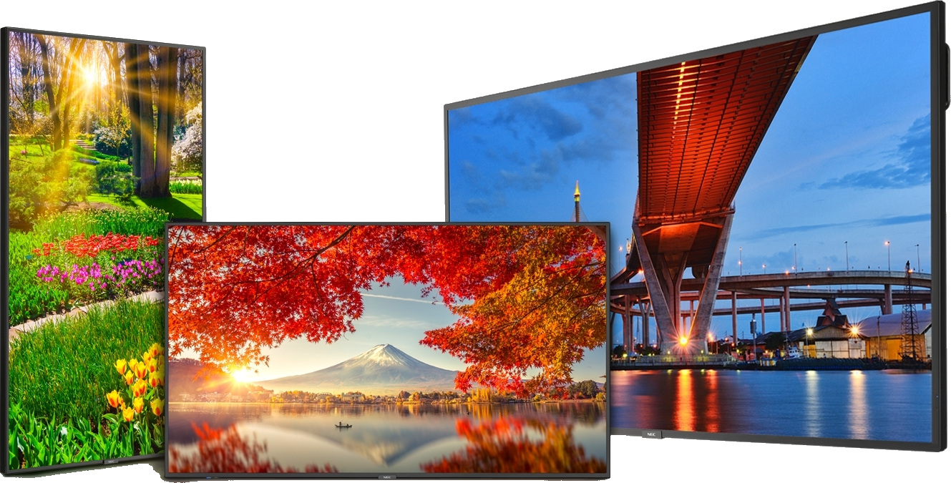
Digital Signage
Play Full-HD Images continuously
Design your content in advance
Set Start/Stop time & Duration of play
Automatically stops on end time
Displays clock in case of no schedule
Download and play locally to save bandwidth
Useful for:
  Banquet, Sales Promotion, Show Offers
  Customised messages & Easy Management

Slide 11
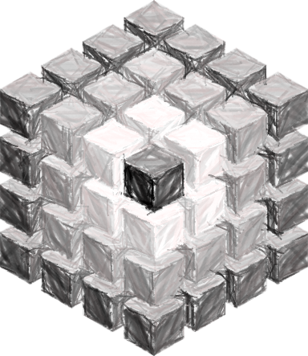

Customer Profiling & Classification
Automatically profiles & classifies* customer
  Copper : Newly registered customer
  Silver : Low affordable customer
  Gold : Medium affordable customer
  Platinum : High affordable customer
Offered products & services are mapped to similar categories
Automated marketing suggests correct product & service according to the category they belong
Advanced Machine Learning algorithms to detect, profile & classify customers
* Conditions apply

Slide 12
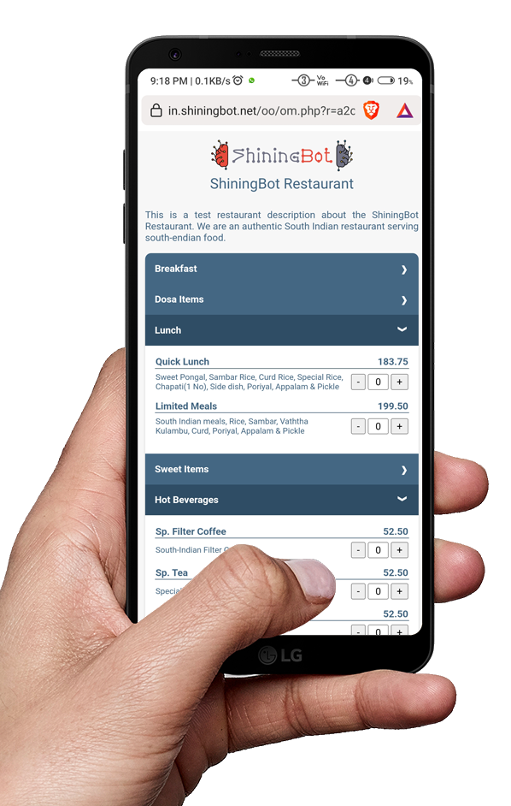
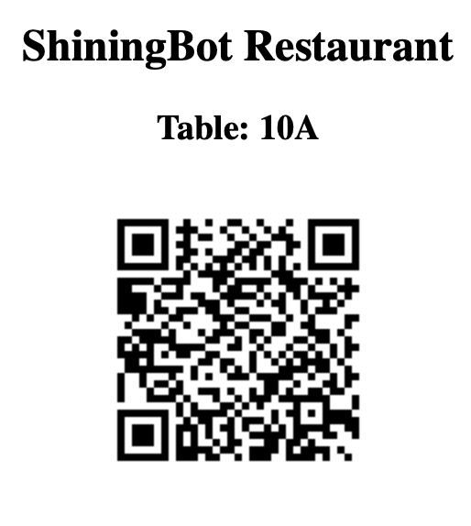
Self Service Menu, Order & KOT printing
Manage Restaurant, Room Service & Amenities supply using self-service system
Easily generate Room-wise/Table-wise QR Code
User can scan QR code / No need to install any APP
Menu items show based on the availability time
Provision to disable items from display
Immediately prints KOT on confirmation by user
Saves man-power in order taking and communication errors

Slide 13
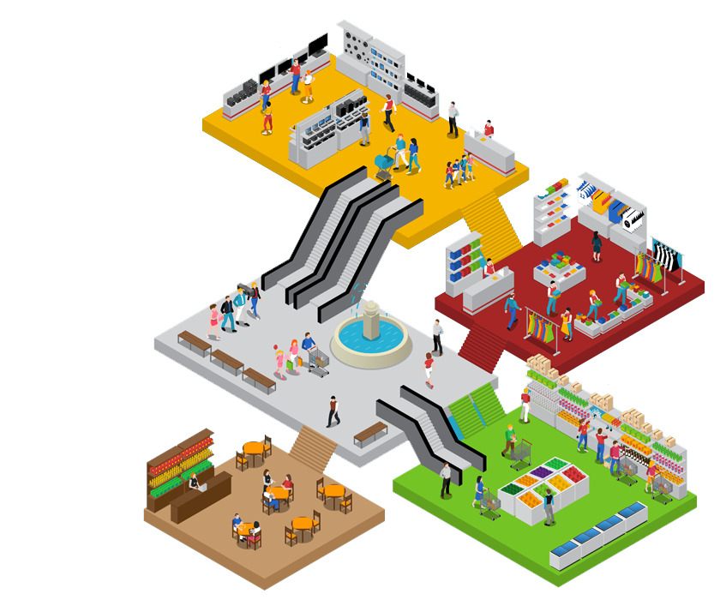
Location based Service & Advertisement
Shining Bot learns customers location
From location, it learns customer interests
Track movement of customer within premises
Push SMS / WhatsApp notification based on entry/exit of specific location within your premises
Track usage of lift/escalator & in turn power
Helps to reorganize your store layout
Helps to find most used/unused locations
Provides visitor count for each location
Pushes advertisement in login/status pages

Slide 14

Artificial Intelligence based Automated Marketing
Shining Bot learns following information
  Affordability level of customer
  Product / Service Interested
  Visiting patterns & trends
  Customer’s impressions & sentiments
Based on above information Shining Bot selects right kind of product / service suitable for customer
Provides automatic marketing by SMS
Informs about stock replenishment of their interested products
Tracks whether they visit or not

Slide 15

Business Intelligence & Key Performance Indicators
Constantly collected information are processed in Shining Bot cloud and Business Intelligence reports are generated
Reports are accessible from Shining Bot portal
Key Performance Indicators are scientific way of measuring the heartbeat of any business
Shining Bot provides following KPI reports
  Foot traffic (Over all & Location wise)
  Customer Satisfaction
  Net Promotor Score
  Customer retention
  Customer Dwell Time

Slide 16

Application Programming Interface
Shining Bot provides API, that can connect to:
  Most industry leading PMS solutions
  Most industry leading Database Management Systems
We can also customize our interface to connect to your proprietary software
We also provide API to customize your development based on the Shining Bot platform
API services are custom designed for the individual requirement, talk to Shining Bot solution expert for more information

Slide 17

ShiningBot License Options
Product Features | Silver | Gold | Platinum
Dual WAN with Link Failure & Notification | ✓ | ✓ | ✓
Authentication (MAC, Self-Registration, Operator Assisted & API) | ✓ | ✓ | ✓
Log retention up to 18 months as per norms | ✓ | ✓ | ✓
Assistance in Cybercrime Investigation | ✓ | ✓ | ✓
Login wise Bandwidth and Concurrency Control | ✓ | ✓ | ✓
In-Premises Feedback Management | ✓ | ✓ | ✓
Image / Video advertisements in Login, Logout & Status Pages | ✓ | ✓ | ✓
Promotional SMS / WhatsApp – One shot message to customers | ✓ | ✓ | ✓
KPI Reports |  | ✓ | ✓
Feedback Anywhere – Off-Premises Short URL based feedback |  | ✓ | ✓
VIP Recognition |  | ✓ | ✓
Consumer Behavior Analysis of Users |  |  | ✓
Profiling and Classifications of Users |  |  | ✓
Location based Services* (Preference/Interest Tracking, Messaging) |  |  | ✓
AI Based automated marketing |  |  | ✓
Content Filter* | Optional | Optional | Optional
Digital Signage License* | 1 Free | 1 Free | 1 Free
* - Conditions Apply

Slide 18
Why Shining Bot …
Exploit the power of Ai & Machine Learning technology for your business development
Provides complete insights about business and operation using WiFi
State of the art solution to improve the business process & profits
Explore the hidden data in your business to exploit the opportunities
It follows your customer even outside your business premises
Increases customer satisfaction by enhancing the experience

Slide 19

ShiningBot Data Analytics (P) Limited
F3 – Nathigam Building, 97/55, NSK Salai (Arcot Road), Kodambakkam, Chennai – 600 024, TN, India
www.shiningbot.com | info@shiningbot.com

